Slide 1
API Testing Using Cypress
Base URL: https://jsonplaceholder.typicode.com
Presented by Muhammad Huzaifa Asif

Slide 2
Project Structure
Testing Framework: Cypress
Mock API : JSONPlaceholder
Report Tool : Mochawesome
Test Runner : Cypress Test Runner
Organize using POM

Slide 3
Test Scenarios
Method | Endpoint | Scenrio
GET | /posts | Get all post
GET | /posts/id | Get post by valid/invalid id
GET | /comment | Get all comments
POST | /posts | Get comment by valid/invalid id
PUT | /posts/id | Update post
DELETE | /posts/id | Delete post

Slide 4
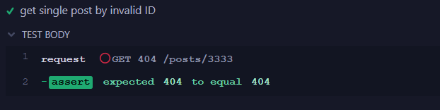
Invalid Case
export const getpostInvalidId = (id) => {
return cy.request({
url: `/posts/${id}`,
failOnStatusCode: false
});
};

Slide 6
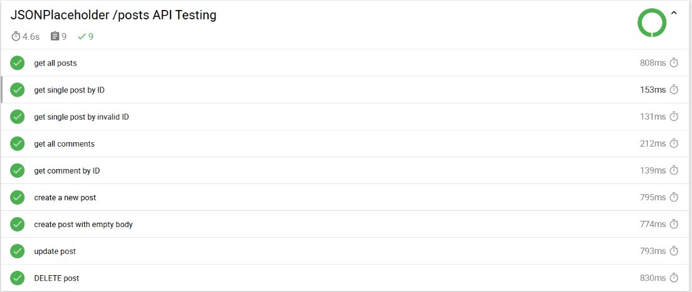
Report

